Slide 1
UNIT-V UNSOLVABLE PROBLEMS AND COMPUTABLE FUNCTIONS

Slide 2
CHAPTER 1: UNSOLVABLE PROBLEMS AND COMPUTABLE FUNCTIONS
Primitive recursive functions
Recursive and recursively enumerable languages
Universal Turing machine.
CHAPTER 2: MEASURING AND CLASSIFYING COMPLEXITY:
Tractable and Intractable problems
Tractable and possibly intractable problems
P and NP completeness
Polynomial time reductions.

Slide 3
UNDECIDABLE
A problem is undecidable if it cannot be solved by any Turing machine that halts on all inputs.
Note that the corresponding language of an undecidable problem is non-recursive.

Slide 4
Turing-Computable Functions
A total function f: Σ* → Σ* is Turing-computable if there exists a DTM M such that for every x in Σ*,
(s, BxB) ├* (h, Bf(x)B).
A partial f: Ω → Σ* is Turing-computable if there exists a DTM M such that L(M)=Ω and for every x in Ω,
(s, BxB) ├* (h, Bf(x)B).

Slide 5
The following function f is Turing-computable:
f(x) = w, if x = ww ;
↑, otherwise
(s, B0110B)├ (q, B0110B)├ (q0, B011BB)
├* (q0, B011B) ├ (p0, B011B)├ (ok, B0’11B)
├* (ok, B0’11B) ├ (q, B0’11B) ├ (q1, B0’1BB)
├ (q1, B0’1B) ├ (p1, B0’1B) ├ (ok, B0’1’B)
├ (q, B0’1’B) ├ (r, B0’1B) ├* (r, B01B)
├ (o, B01B) ├* (o, B01B)├ (k, B01BB)
├ (h, B01B)
R

Slide 6
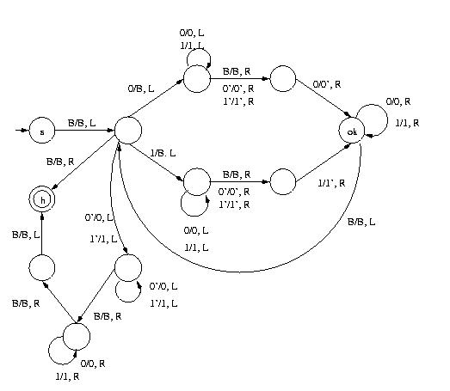
R
f(x) = w if x = ww ; ↑, otherwise

Slide 7
Turing-decidable
A language A is Turing-decidable if its characteristic function is Turing-computable.
Χ (x) = {
1, if x ε A
A
0, otherwise

Slide 8
{ ww | w ε (0+1)*} is Turing-decidable.
(s, B0110B)├ (q, B0110B)├ (q0, B011BB)
├* (q0, B011B) ├ (p0, B011B)├ (ok, B$11B)
├* (ok, B$11B) ├ (q, B$11B) ├ (q1, B$1BB)
├ (q1, B$1B) ├ (p1, B$1B) ├ (ok, B$$B)
├ (q, B$$B) ├ (r, B$BB) ├* (r, BBB)
├ (o, BBB) ├* (h, B1B)
R

Slide 9
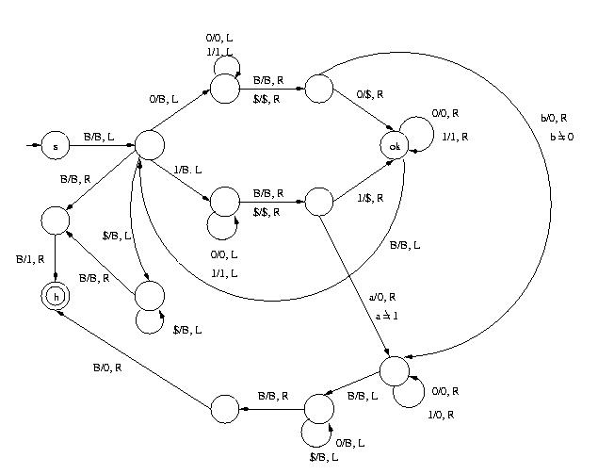

Slide 10
Some Primitive Recursive Functions
In order to prove that a function is primitive recursive, we have to show how that function can be derived from the initial functions by using composition and recursion.

Slide 11
Some Primitive Recursive Functions
Remember? The recursive definition of a function looks like this:
h(x₁, …, x_{n}, 0) = f(x₁, …, x_{n})
h(x₁, …, x_{n}, t + 1) = g(t, h(x₁, …, x_{n}, t), x₁, …, x_{n}) .
If f is a function of k variables, g₁, …, g_{k} are functions of n variables, and
h(x₁, …, x_{n}) = f(g₁(x₁, …, x_{n}), …, g_{k}(x₁, …, x_{n})).
Then h is said to be obtained from f and g₁, …, g_{k} by composition.

Slide 12
Some Primitive Recursive Functions
We defined the following initial functions:
s(x) = x + 1
n(x) = 0
u_{i}^{n}(x₁, …, x_{n}) = x_{i} , 1 ≤ i ≤ n.

Slide 13
Some Primitive Recursive Functions
Example 1: f(x, y) = x + y
We can transform this into a recursive definition:
f(x, 0) = x
f(x, y + 1) = f(x, y) + 1
This can be rewritten as:
f(x, 0) = u₁¹(x)
f(x, y + 1) = g(y, f(x, y), x)
where g(x₁, x₂, x₃) = s(u₂³(x₁, x₂, x₃)).
Obviously, u₁¹(x), u₂³(x₁, x₂, x₃), and s(x) are primitive recursive functions – they are initial functions.
g(x₁, x₂, x₃) is obtained by composition of primitive recursive functions, so it is primitive recursive itself.
Therefore, f(x, y) = x + y is primitive recursive.

Slide 14
Complements of Recursive Languages
Theorem: If L is a recursive language, L is also recursive.
Proof: Let M be a TM for L that always halt. We can construct another TM M from M for L that always halts as follows:
M
Accept
Accept
Input
M
Reject
Reject

Slide 15
Complements of RE Languages
Theorem: If both a language L and its complement L are RE, L is recursive.
Proof: Let M₁ and M₂ be TM for L and L respectively. We can construct a TM M from M₁ and M₂ for L that always halt as follows:
M
M₁
Accept
Accept
Input
M₂
Accept
Reject

Slide 16
A Non-recursive RE Language
We are going to give an example of a RE language that is not recursive, i.e., a language L that can be accepted by a TM, but there is no TM for L that always halt.
Again, we need to make use of the binary encoding of a TM.

Slide 17
L_{d}
We will now
look at an
example in
this region.
Recursive
Recursively
Enumerable (RE)
Non-recursively
Enumerable (Non-RE)

Slide 18
A Non-recursive RE Language
Recall that we can encode each TM uniquely as a binary number and enumerate all TM’s as T₁, T₂, …, T_{k}, … where the encoded value of the k^{th} TM, i.e., T_{k}, is k.
Consider the language L_{u}:
L_{u} = {(k, w) | T_{k} accepts input w}
This is called the universal language.

Slide 19
Universal Language
Note that designing a TM to recognize L_{u} is the same as solving the problem of given k and w, decide whether T_{k} accepts w as its input.
We are going to show that L_{u} is RE but non-recursive, i.e., L_{u} can be accepted by a TM, but there is no TM for L_{u} that always halt.

Slide 20
Universal Turing Machine
To show that L_{u} is RE, we construct a TM U, called the universal Turing machine, such that L_{u} = L(U).
U is designed in such a way that given k and w, it will mimic the operation of T_{k} on input w:
1
1
1
1
1
1
0
k
separator
w
U will move back and forth to mimic T_{k} on input w.

Slide 21
Universal Turing Machine
Accept
Accept
(k, w)
T_{k}
w
i.e., k1111110w
U
Why cannot we use a similar method to construct
a TM for L_{d}?

Slide 22
Universal Language
Since there is a TM that accepts L_{u}, L_{u} is RE. We are going to show that L_{u} is non-recursive.
If L_{u} is recursive, there is a TM M for L_{u} that always halt. Then, we can construct a TM M’ for L_{d} as follows:
k1111110k
Accept
Reject
k
Copy
M
Reject
Accept
M’

Slide 23
A Non-recursive RE Language
Since we have already shown that L_{d} is non-recursively enumerable, so M’ does not exist and there is no such M.
Therefore the universal language is recursively enumerable but non-recursive.

Slide 24
Modified Post Correspondence Problem (MPCP)
Given two lists A and B:
A = w₁, w₂, …, w_{k} B = x₁, x₂, …, x_{k}
The problem is to determine if there is a sequence of one or more integers i₁, i₂, …, i_{m} such that:
w₁w_{i1}w_{i2}…w_{im} = x₁x_{i1}x_{i2}…x_{im}
(w_{i}, x_{i}) is called a corresponding pair.

Slide 25
Example
A
B
i
w_{i}
x_{i}
1
11
1
2
1
111
3
0111
10
4
10
0
This MPCP instance has a solution: 3, 2, 2, 4:
w₁w₃w₂w₂w₄ = x₁x₃x₂x₂x₄ = 1101111110

Slide 26
Class Discussion
A
B
i
w_{i}
x_{i}
1
10
101
2
011
11
3
101
011
Does this MPCP instance have a solution?

Slide 27
Undecidability of PCP
To show that MPCP is undecidable, we will reduce the universal language problem (ULP) to MPCP:
If MPCP can be solved, ULP can also be solved. Since we have already shown that ULP is un-decidable, MPCP must also be undecidable.
Universal
Language
Problem (ULP)
A mapping
MPCP

Slide 28
Mapping ULP to MPCP
Mapping a universal language problem instance to an MPCP instance is not as easy.
In a ULP instance, we are given a Turing machine M and an input w, we want to determine if M will accept w.
To map a ULP instance to an MPCP instance success-fully, the mapped MPCP instance should have a solution if and only if M accepts w.

Slide 29
Mapping ULP to MPCP
ULP instance
MPCP instance
Construct an
MPCP instance
Given:
(T,w)
Two lists:
A and B
If T accepts w, the two lists can be matched.
Otherwise, the two lists cannot be matched.

Slide 30
Mapping ULP to MPCP
We assume that the input Turing machine T:
Never prints a blank
Never moves left from its initial head position.
These assumptions can be made because:
Theorem (p.346 in Textbook): Every language accepted by a TM M₂ will also be accepted by a TM M₁ with the following restrictions: (1) M₁’s head never moves left from its initial position. (2) M₁ never writes a blank.

Slide 31
Mapping ULP to MPCP
Given T and w, the idea is to map the transition function of T to strings in the two lists in such a way that a matching of the two lists will correspond to a concatenation of the tape contents at each time step.
We will illustrate this with an example first.

Slide 32
Example of ULP to MPCP
Consider the following Turing machine:
T = ({q₀, q₁},{0,1},{0,1,#}, δ, q₀, #, {q₁})
δ(q₀,1)=(q₀,0,R) δ(q₀,0)=(q₁,0,L)
Consider input w=110.
q₀
0/0, L
q₁
1/0, R

Slide 33
Example of ULP to MPCP
Now we will construct an MPCP instance from T and w. There are five types of strings in list A and B:
Starting string (first pair):
List A List B
# #q₀110#

Slide 34
Example of ULP to MPCP
Strings from the transition function δ:
List A List B
q₀1 0q₀ (from δ(q₀,1)=(q₀,0,R))
0q₀0 q₁00 (from δ(q₀,0)=(q₁,0,L))
1q₀0 q₁10 (from δ(q₀,0)=(q₁,0,L))

Slide 35
Example of ULP to MPCP
Strings for copying:
List A List B
# #
0 0
1 1

Slide 36
Example of ULP to MPCP
Strings for consuming the tape symbols at the end:
List A List B List A List B
0q₁ q₁ 0q₁1 q₁
1q₁ q₁ 1q₁0 q₁
q₁0 q₁ 0q₁0 q₁
q₁1 q₁ 1q₁0 q₁

Slide 37
Example of ULP to MPCP
Ending string:
List A List B
q₁## #
Now, we have constructed an MPCP instance.

Slide 38
Example of ULP to MPCP
List A List B List A List B
1. # #q₀110# 9. 0q₁ q₁
2. q₀1 0q₀ 10. 1q₁ q₁
3. 0q₀0 q₁00 11. q₁0 q₁
4. 1q₀0 q₁10 12. q₁1 q₁
5. # # 13. 0q₁1 q₁
6. 0 0 14. 1q₁0 q₁
7. 1 1 15. 0q₁0 q₁
8. q₁## # 16. 1q₁0 q₁

Slide 39
Example of ULP to MPCP
This ULP instance has a solution:
q₀110 → 0q₀10 → 00q₀0 → 0q₁00 (halt)
Does this MPCP instance has a solution?
List A:
# q₀ 1 1 0 # 0 q₀ 1 0 # 0 0 q₀ 0 # 0 q₁ 0 0 # q₁ 0 # q₁ # #
List B:
# q₀ 1 1 0 # 0 q₀ 1 0 # 0 0 q₀ 0 # 0 q₁ 0 0 # q₁ 0 # q₁ # #
The solution is the sequence of indices:
2, 7, 6, 5, 6, 2, 6, 5, 6, 3, 5, 15, 6, 5, 11, 5, 8

Slide 40
MEASURING TIME COMPLEXITY
We measure time complexity by counting the elementary steps required for a machine to halt
Consider the language A = { 0^{k}1^{k} | k ≥ 0 }
1. Scan across the tape and reject if the string is not of the form 0^{m}1^{n}
2k
2. Repeat the following if both 0s and 1s remain on the tape:
Scan across the tape, crossing off a
single 0 and a single 1
2k²
3. If 0s remain after all 1s have been crossed off, or vice-versa, reject. Otherwise accept.
2k

Slide 41
The number of steps that an algorithm uses on a particular input may depend on several parameters.
For instance, if the input is a graph, then the number of steps may depend on the number of nodes, the number of edges, et cetera.
For simplicity, we compute the running time purely as a function of the length of the input string and don’t consider any other parameters.

Slide 42
Let M be a TM that halts on all inputs.
Assume we compute the running time purely as a function of the length of the input string.
Definition: The running time or time-complexity function of M is the function f : N → N such that f(n) is the maximum number of steps that M uses on any input of length n.

Slide 43
Definition: TIME(t(n)) is the set of languages decidable in O(t(n)) time by a Turing Machine.
{ 0^{k}1^{k} | k ≥ 0 } ∈ TIME(n²)

Slide 44
A = { 0^{k}1^{k} | k ≥ 0 } ∈ TIME(n log n)
Cross off every other 0 and every other 1. If the # of 0s and 1s left on the tape is odd, reject.
00000000000001111111111111
x0x0x0x0x0x0xx1x1x1x1x1x1x
xxx0xxx0xxx0xxxx1xxx1xxx1x
xxxxxxx0xxxxxxxxxxxx1xxxxx
xxxxxxxxxxxxxxxxxxxxxxxxxx

Slide 45
Can A = { 0^{k}1^{k} | k ≥ 0 } be decided in time O(n) with a two-tape TM?
Scan all 0s and copy them to the second tape.
Scan all 1s, crossing off a 0 from the second tape for each 1.

Slide 46
Polynomial Time
∪
P = TIME(n^{k})
k ∈ N

Slide 47
Non-deterministic Polynomial Time
∪
NP = NTIME(n^{k})
k ∈ N

Slide 48
Theorem: L ∈ NP if and only if there exists a poly-time Turing machine V with
L = { x | ∃y. |y| = poly(|x|) and V(x,y) accepts }.
Proof:
If L = { x | ∃y. |y| = poly(|x|) and V(x,y) accepts }
then L ∈ NP.
Because we can guess y and then run V.
(2) If L ∈ NP then
L = { x | ∃y. |y| = poly(|x|) and V(x,y) accepts }
Let N be a non-deterministic poly-time TM that decides L. Define V(x,y) to accept if y is an accepting computation history of N on x.

Slide 49
3SAT =
{ φ | ∃y such that y is a satisfying assignment to φ and φ is in 3cnf }
SAT =
{ φ | ∃y such that y is a satisfying assignment to φ }

Slide 50
POLY-TIME REDUCIBILITY
f : Σ* → Σ* is a polynomial-time computable function
if some poly-time Turing machine M, on every input w, halts with just f(w) on its tape.
Language A is polynomial time reducible to language B, written A ≤_{P} B, if there is a poly-time computable function f : Σ* → Σ* such that:
w ∈ A ⇔ f(w) ∈ B
f is called a polynomial-time reduction of A to B.

Slide 51
A
B
f
f

Slide 52
Theorem (Cook-Levin): SAT is NP-complete.
Proof Outline:
(1) SAT ∈ NP
(2) Every language A in NP is polynomial time
reducible to SAT
We build a poly-time reduction from A to SAT
The reduction turns a string w into a 3-cnf formula φ such that w ∈ A iff φ ∈ 3-SAT.
φ will simulate the NP machine N for A on w.
Let N be a non-deterministic TM that decides A in time n^{k}
How do we know N exists?

